Slide 1
MATLAB绘制动画
drawnow
将更新次数限制为每秒20帧
clear;clc;close all;
h = animatedline;
axis([0 4*pi -1 1])
x = linspace(0,4*pi,2000);
for k = 1:length(x)
y = sin(x(k));
addpoints(h,x(k),y);
drawnow
end
clear;clc;close all;
h = animatedline; axis([0 4*pi -1 1])
x = linspace(0,4*pi,10000); for k = 1:length(x)
y = sin(x(k)); addpoints(h,x(k),y); drawnow limitrate
end
%drawnow

Slide 2
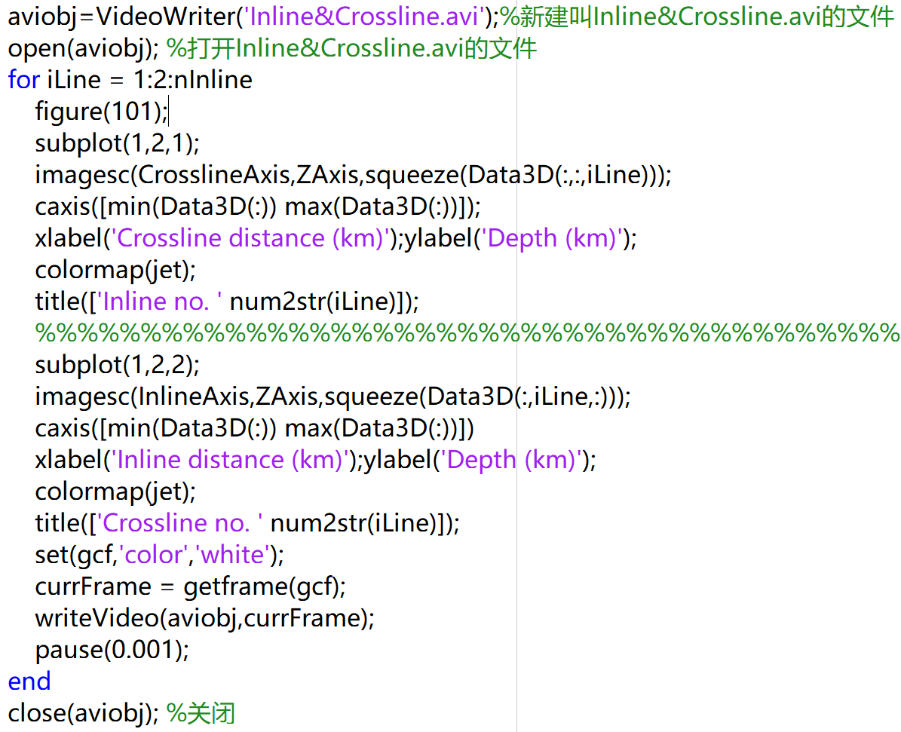
生成avi文件
Chapter04_13Overthrust3D

Slide 3
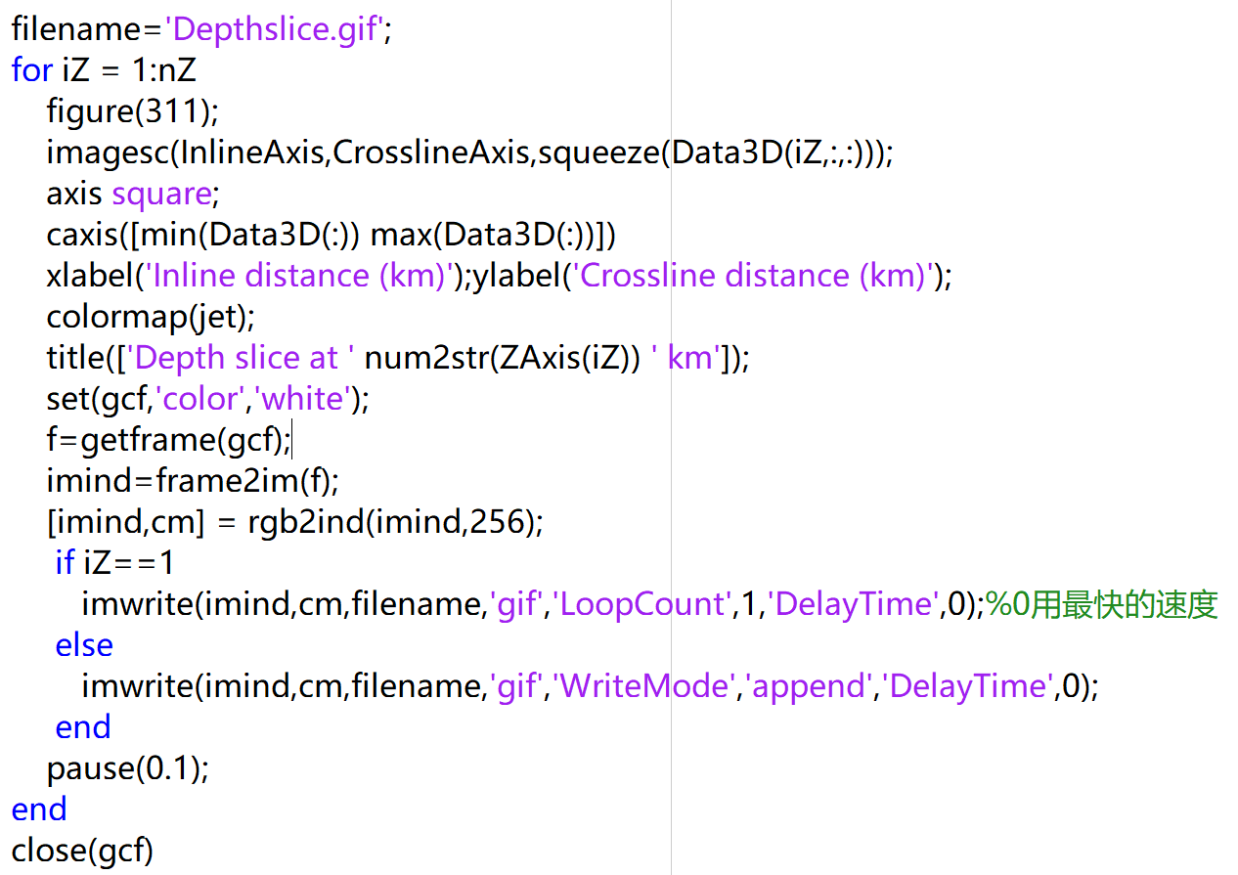
生成gif文件
Chapter04_13Overthrust3D

